Slide 1

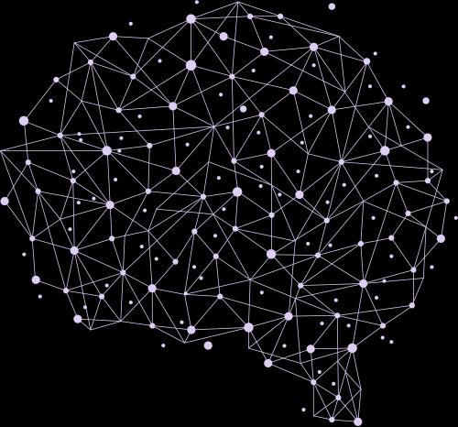

Deep Learning
The Brain Behind Smart Machines

Slide 2



What is Machine Learning (ML)?
Machine Learning (ML) helps machines learn patterns from data without being explicitly programmed.
Examples: Email spam filters, and movie recommendations.
Model
Data
Predection
I know what spam looks like!

Slide 3



Drawbacks of Traditional ML
ML struggles with:
Handling large amounts of data.
Understanding complex patterns like images and videos.
Needing humans to select features manually.
Example: It’s hard for traditional ML to recognize faces accurately.
Too much data! I can’t handle it!

Slide 4






Human
ML
Look a
Cat!
Never Seen it before ...

Slide 5
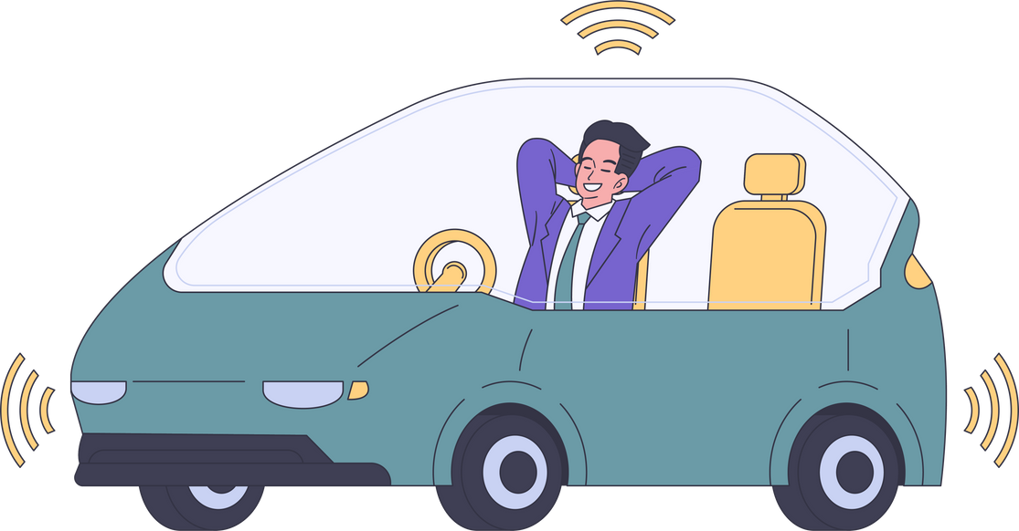



What Did Deep Learning (DL) Solve?
DL uses neural networks to learn patterns directly from raw data.
Handles huge data sets, like images, sound, and text.
Examples: Self-driving cars, facial recognition, chatbots.
Input
Output

Slide 6



What is Deep Learning?
DL is like a virtual brain, inspired by how humans think!
It uses layers of artificial neurons to process information.
The more layers, the "deeper" it is.

Slide 7
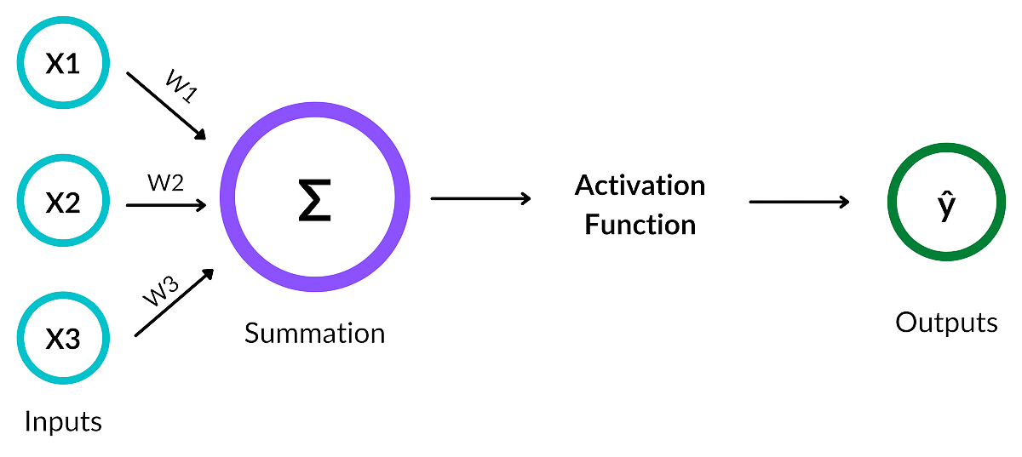
How Does Deep Learning Work?

Slide 8

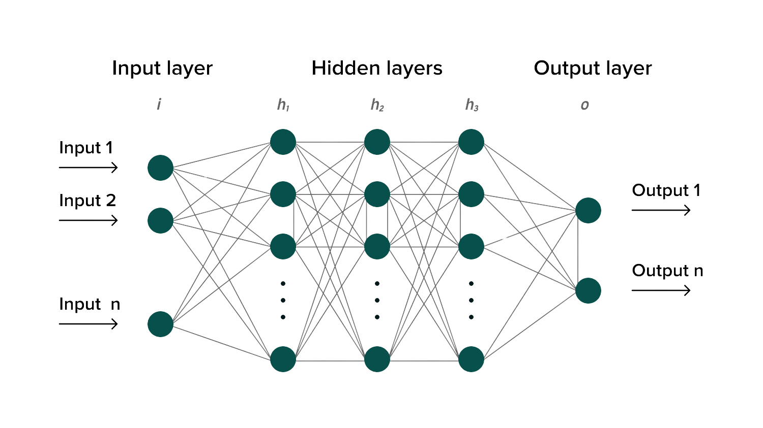

Deep Neural Network

Slide 9
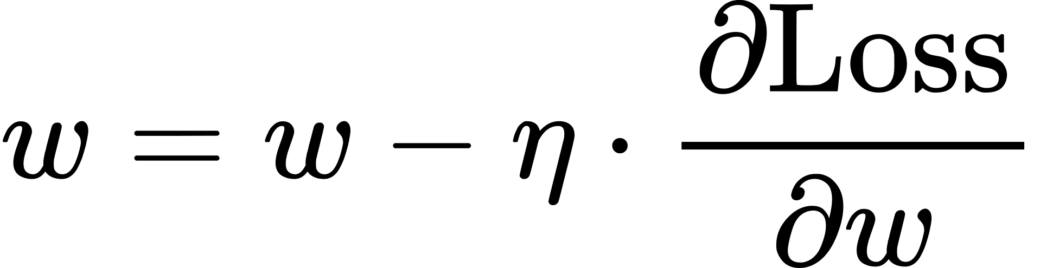
Training Deep Learning Models
Start with random weights (w ) and biases (b).
Make a prediction and calculate error (Loss).
Use backpropagation to adjust weights:
​
Repeat until the error is minimized.
Example: A model predicting house prices based on size.

Slide 10

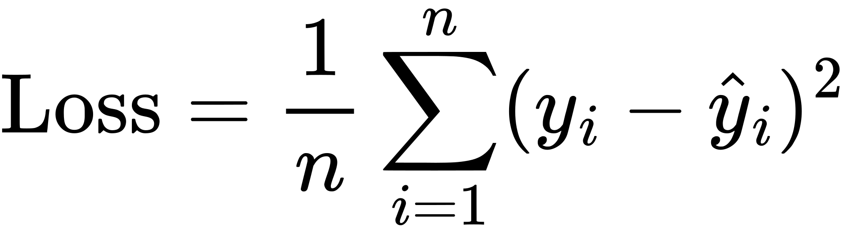
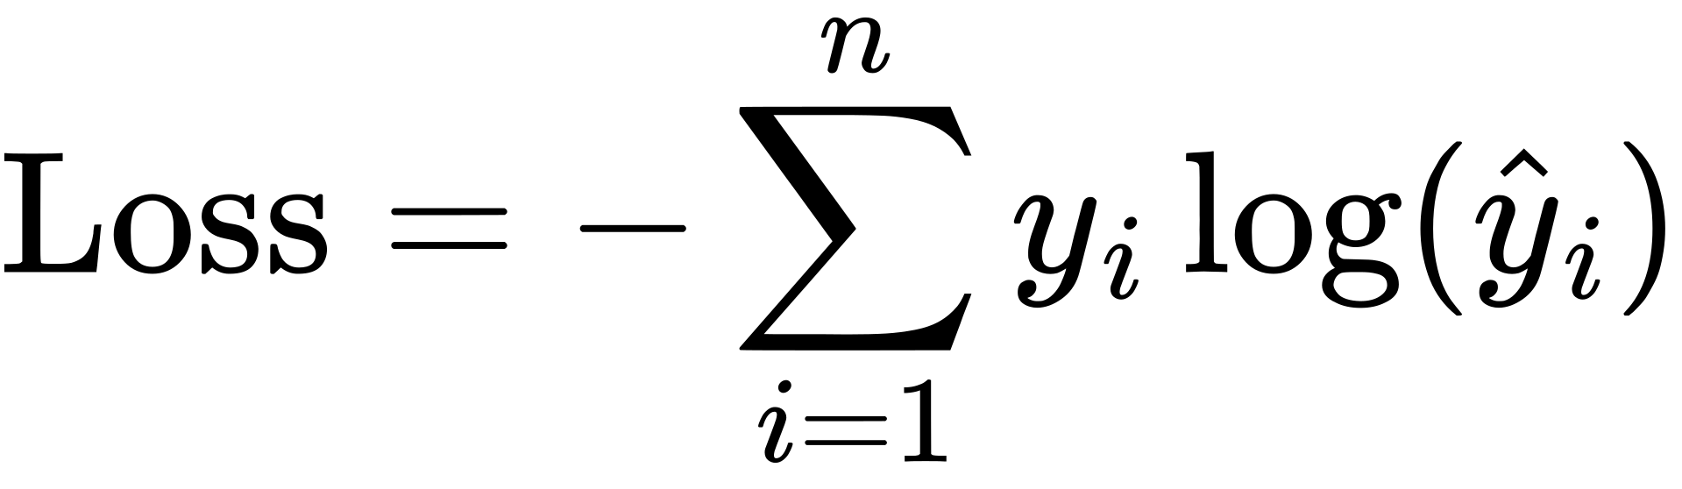
Loss Function
Measures how far the prediction is from the actual value.
Common Loss:
Regression: Mean Squared Error:
Classification: Cross-Entropy Loss:
Goal: Minimize this loss to improve accuracy.

Slide 11
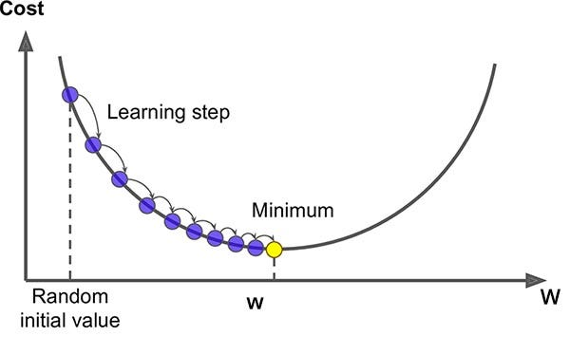
Optimization: Gradient Descent
Adjusts weights to minimize loss:
Take small steps in the direction that reduces error.
Learning Rate (lr): Size of each step.

Slide 12
Genral Neural Network Training
1. Initialize weights (W) and biases (b)
2. Set learning rate (η) and epochs
For each epoch:
Shuffle data and split into mini-batches
For each mini-batch (X, Y):
# Forward Pass: Compute predictions
# Loss: Calculate error
# Backward Pass: Compute gradients
# Update: W = W - η * dW, b = b - η * db
Output trained parameters

Slide 13

Wrap App
1. Why Deep Learning?
Solves complex problems like images, text, and speech.
Learns directly from raw data without manual feature extraction.
2. How Does It Work?
Mimics the human brain with artificial neurons.
Trains using optimization techniques like gradient descent.
3. Applications
Self-driving cars, voice assistants, healthcare, and more.
4. Challenges
Requires large datasets and computing power.
Sometimes, it is difficult to explain its decisions (black box problem).
5. Future of Deep Learning
Enhanced personalization (AI doctors, tutors).
Solving global challenges (climate, healthcare).

Slide 14

Thank You

